Slide 1
IMPLEMENTASI STRUKTUR DATA
JAVA
UI
</>
TIM DOSEN ISD
D3 RPLA
UX

Slide 2
PENDAHULUAN
APA ITU STRUKTUR DATA ?

Slide 3
ALGORITHM ???
STILL REMEMBER?
DEFINITION
WHAT MAKE A GOOD ONE?
A clearly specified set of simple instructions to be followed to solve a problem
PLEASE STATE YOUR OPINION
A good algorithm is ….

Slide 4
Data Structure – REAL WORLD
When you stopped at the store this morning, you went to the back of a line to wait for the cashier.
Do you see a stack of books or a pile of papers on your desk? It’s easy to look at or remove the top. item of the stack or to add a new item to the top of the stack.
At your desk, you see your to-do list. Each entry in the list has a position that might or might not be important to you.

Slide 5
Data Structure – REAL WORLD
Your dictionary is an alphabetical list of words and their definitions.
Speaking of your computer, you have organized your files into folders, or directories. Each folder contains several other folders or files.
Finally, notice the road map that you are using to plan your weekend trip. The diagram of roads and towns shows you how to get from one place to another.

Slide 6
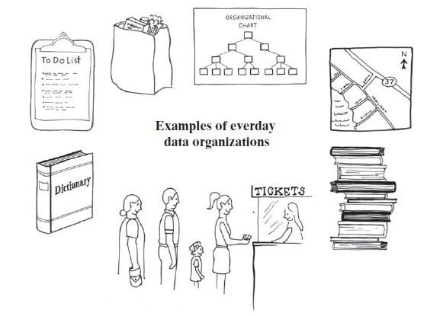
Data Structure - Definition
A data structure is a way of organizing input data and operations which can be performed on this data (e.g. add, delete, find an element).
Notes:
Data structures: to store data in an efficient way
Why to use data structures?
We often have the intuition → if we want to make an algorithm fast, we have to optimize it
Avoid nested for loops
Make every calculation as fast as possible
Algorithms can be boosted up by proper data structures.
Data structures make sure the running time will be better.

Slide 7
COMMON ACTIONs IN DATA STRUCTURE
Traversing
INSERTING
Traverse the collection (beginning – end)
Insert a member (front/ back/ middle)
SEARCHING
DELETING
Search a spesific value
Delete a member

Slide 8
The data structures govern the space and time consumed by your running program.
In addition, large programs take time to write. Using different structures can actually have an impact on how long it takes to write your program.
Choosing the wrong structures can cause your program to run poorly or be difficult or impossible to implement effectively.
Algorithm + data structure = program
So, why data structure?

Slide 9
ALGORITHM + DATA STRUCTURE “PROGRAM”
//
api

Slide 10
Example of Data Structure
Array
Linked List
Stack
Queue
Tree
Graph

Slide 11
LINEAR DS
NON-LINEAR DS
Array
Linked List
STACK
QUEUE
TREE
GRAPH

Slide 12
DATA STRUCTURE VS DATABASE (??)
Database | Data Structure
It is an organized collection of data. | It is a special format for storing data to serve a particular purpose.
It is used to access the data and manage it easily. | It is used for efficiency and to reduce the complexities of the program.
Structured query language (SQL) is used to perform operations on the data in a database. DataBase Management System (DBMS) is used to manage the database. | Programming languages like C, C++, Java, Python are used to perform operations using data Structures.
It is a Non-volatile memory. | It is a volatile memory.
Relational database, NOSQL database, Centralized database, Hierarchical database are some types of databases. | Linear data structure and non-linear data structure are the types of data structures.
Example : MySQL, Oracle, MongoDB, Sybase etc. | Example : Array, Linked List, Stack, Queue, Tree, Graph.
Store Data in permanent Memory | Store Data in Temporary Memory

Slide 13
REFERENCES
Carrano, Frank., Data Structure and Abstraction, Prentice Hall
Geeks for Geeks, “Overview of Data Structures | Set 1 (Linear Data Structures)”, https://www.geeksforgeeks.org/overview-of-data-structures-set-1-linear-data-structures/ , diakses tanggal 16 Februari 2022
Geeks for Geeks, “Difference between Database and Data Structure”, https://www.geeksforgeeks.org/difference-between-database-and-data-structure/ , diakses tanggal 16 Februari 2022

Slide 14
THANKS!
Do you have any questions?
Please keep this slide for attribution

Slide 15


